Slide 1
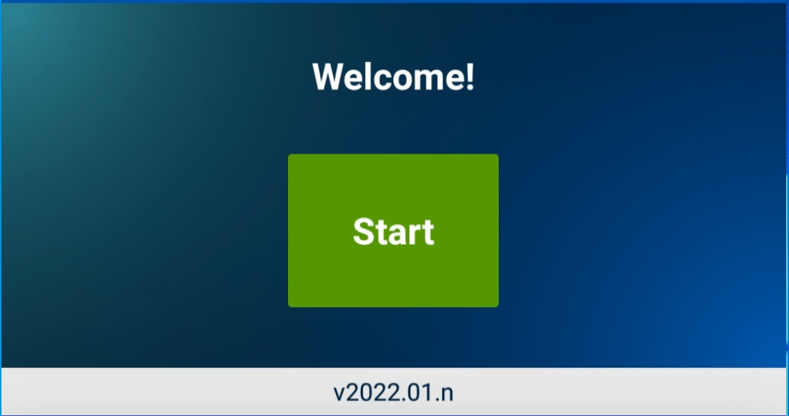
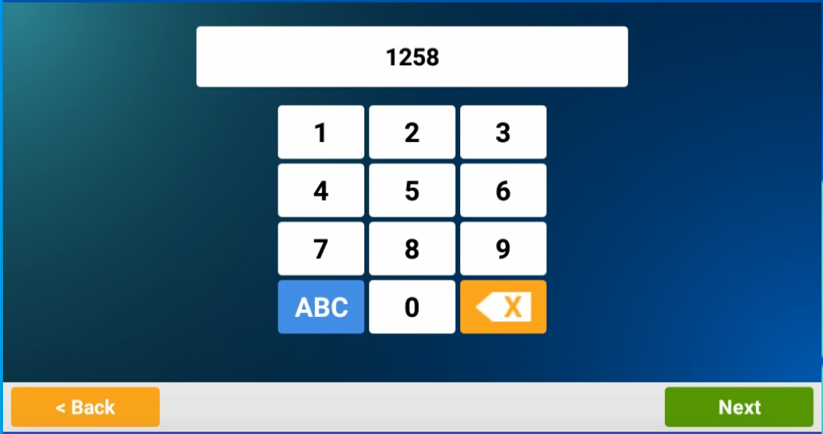
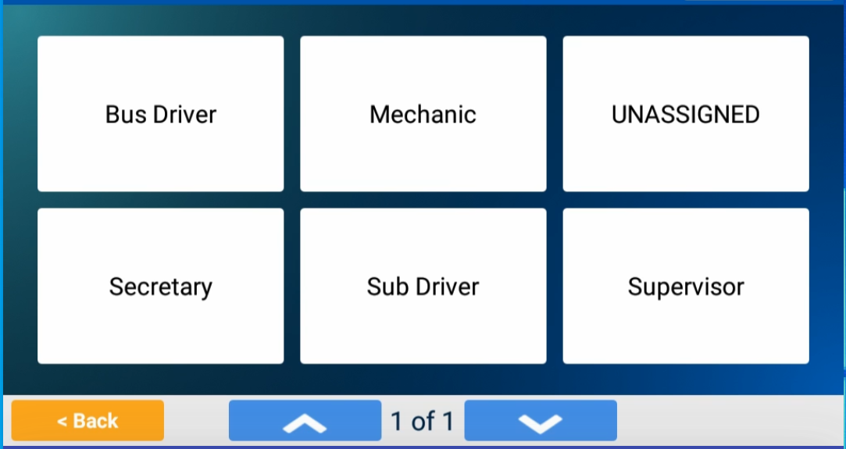
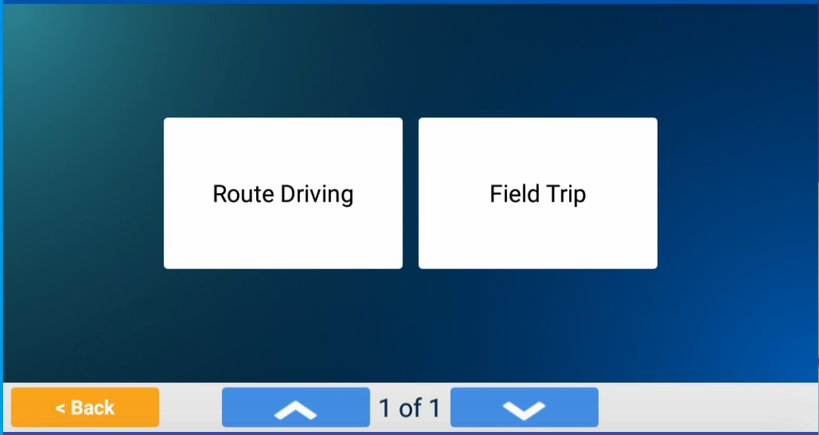
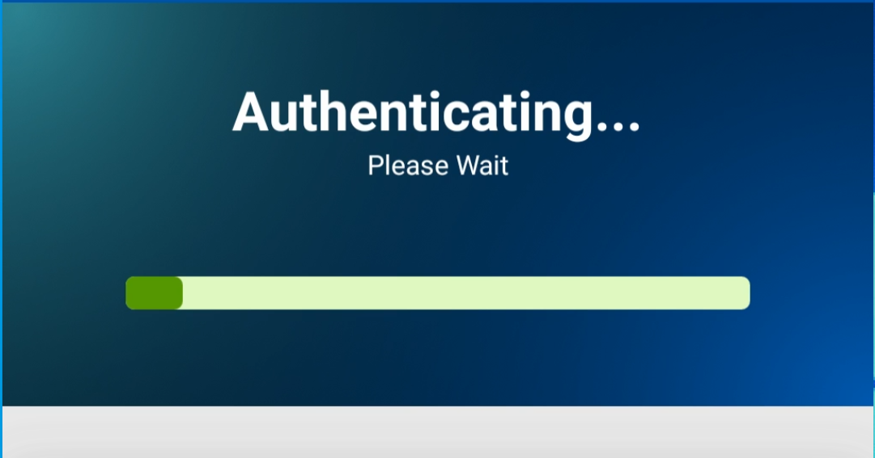
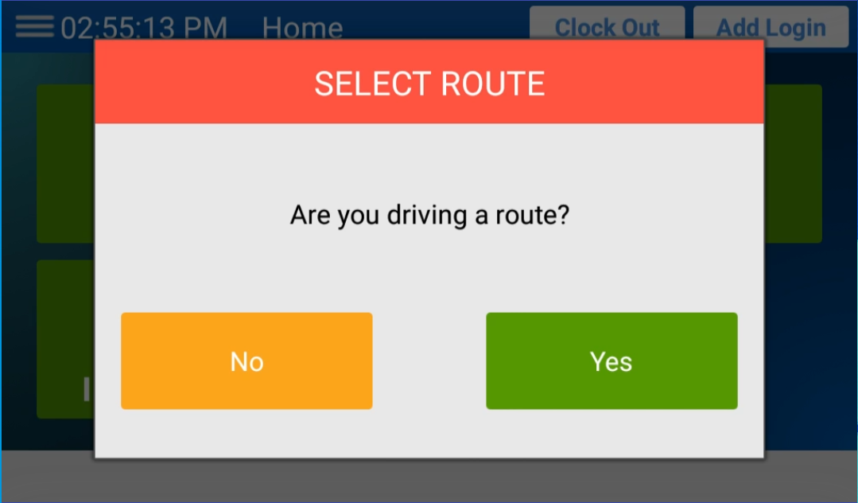
MDT 2022.01 Quick Reference Document – Logging In
1.) On the Welcome screen, tap Start. | 2.) Enter your ID number. (Press ABC to enter letters.) 3.) Tap Next. | 4.) Select your employee type (such as Driver or Monitor). | 5.) Select the job type you are performing (such as Route Driving or Field Trip).
The system will attempt to authenticate your employee ID. | 6.) If you are identified by name, tap Continue. | 7.) If the authentication fails, tap Try Again. (Tap Continue after several failed attempts.) | The Home screen will be displayed. You are now logged onto the MDT.

Slide 2
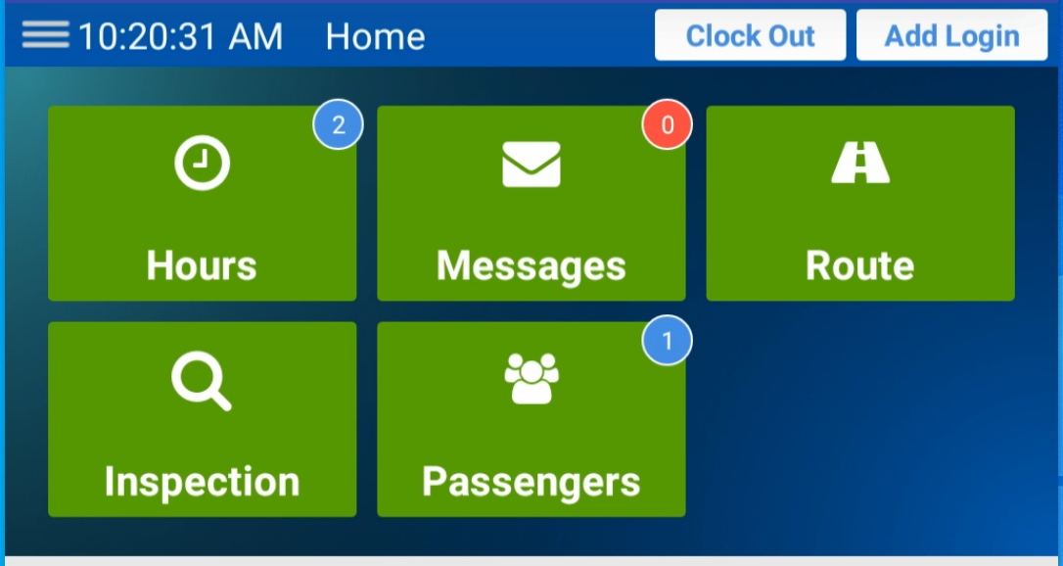
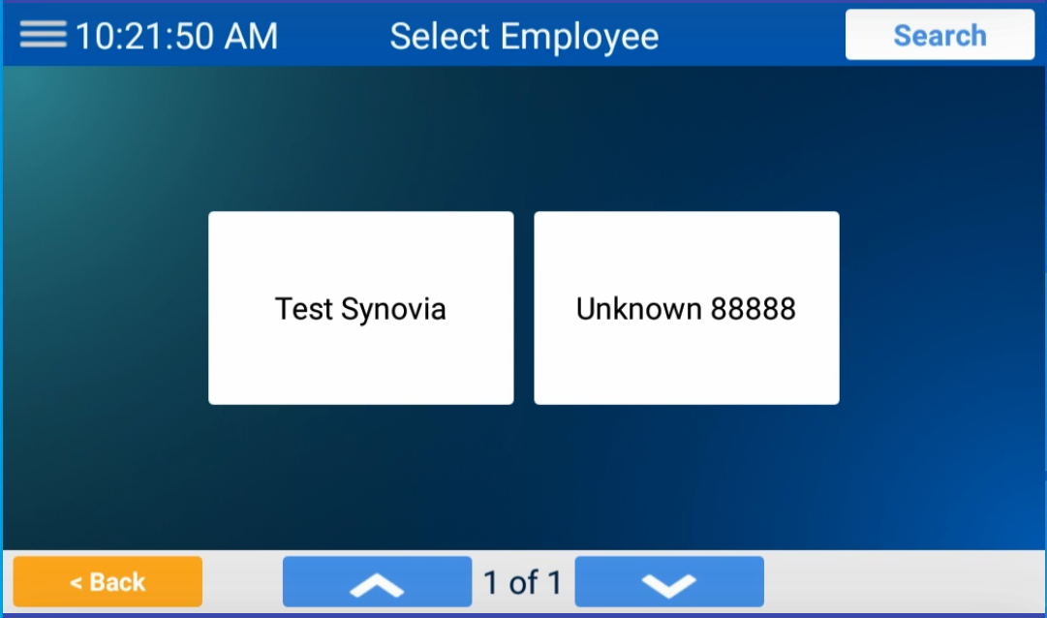
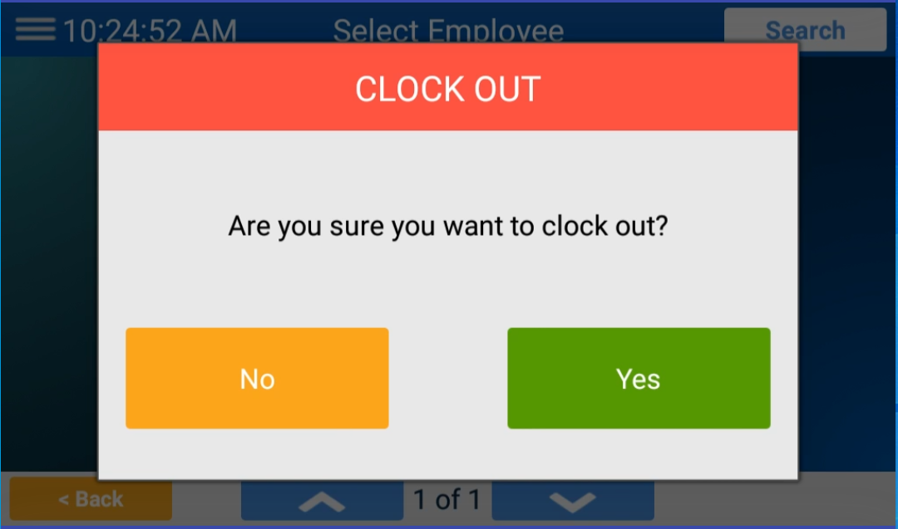
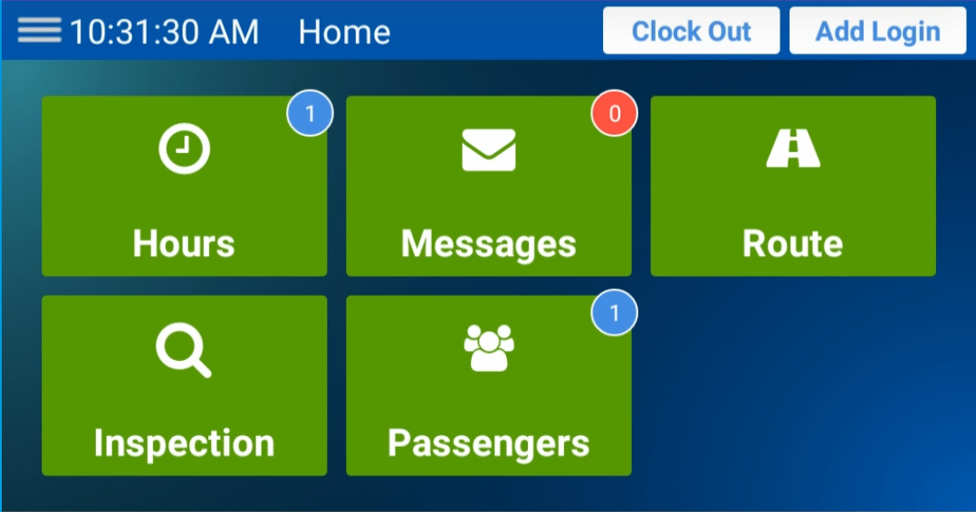
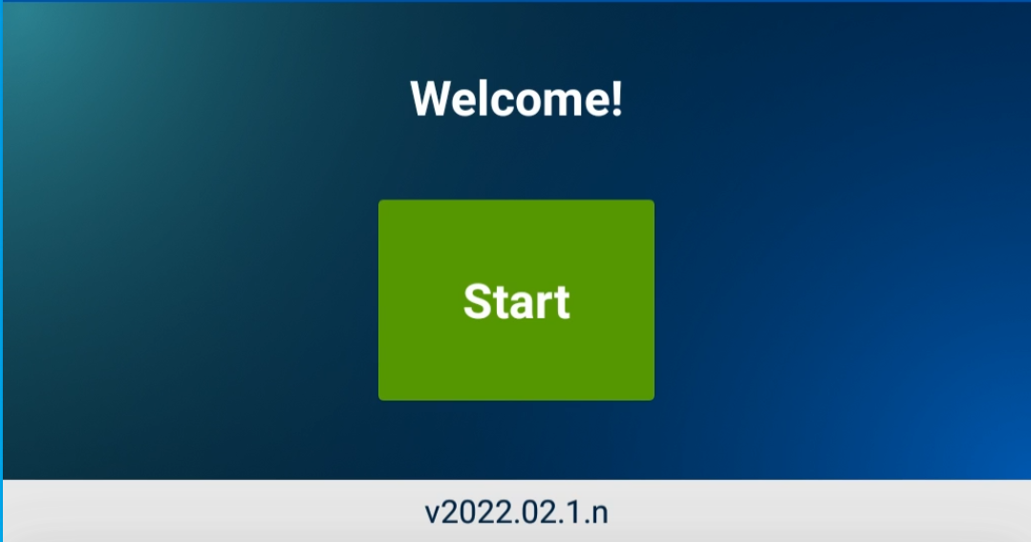
MDT 2022.01 Quick Reference Document – Logging Out
1.) On the Home screen, tap the Clock Out button. | 2.) If two or more employees are logged onto the tablet, select your name. | 3.) Tap Yes to log out. (You can tap No to remain logged on.) | You will be returned to the Select Route screen if other employees are still logged on.
4.) Tap No to dismiss the Select Route screen and return Home. | 5.) To log off another employee, repeat steps 1 through 3. | You will be returned to the Welcome screen. You are now logged out.

